Slide 1
FinCombat : Empower Your Finances, One Game at a Time
Unlock Financial Literacy Through Interactive Adventure

Slide 2
Team Name and Member Details
Team Name: NebuTriX
Member: I'm Shambhavi Mishra, an enthusiastic explorer and lifelong learner. With an interest in web development, I've honed my skills in the MERN stack and Java backend. While my experience in machine learning is limited, I'm eager to delve deeper. I embrace challenges as opportunities to grow and thrive. As a self-proclaimed "pull stack developer," I enjoy sourcing and integrating diverse elements from the web to create cohesive and innovative solutions. With a curious mind and a penchant for problem-solving, I'm dedicated to crafting code that's not just functional but also impactful.
Associated Links :
Website: https://nebulatris.co/
GitHub: https://github.com/NebulaTris
LinkedIn: https://www.linkedin.com/in/nebulatris
Theme
Financial Literacy for all

Slide 3
Problem Statement
Financial illiteracy is a pressing issue both in India and globally, with its repercussions felt far and wide. In India, only about 27% of adults possess the necessary financial knowledge and skills to navigate the complexities of personal finance confidently. This deficiency in financial understanding hampers individuals' capacity to make informed decisions about their money, leading to challenges in managing finances effectively and attaining financial security. Certain demographics, such as women and those residing in rural or economically disadvantaged regions, face even greater barriers to financial literacy. For instance, only 20% of women in India are financially literate, compared to 27% of men. This disparity exacerbates existing socioeconomic inequalities, leaving women particularly vulnerable to financial exploitation and hardship. The repercussions of financial illiteracy extend beyond the individual level, casting a shadow on macroeconomic stability. A lack of financial literacy translates into lower rates of savings and investment, impeding capital formation and constraining resources for productive economic endeavors. Consequently, economic growth and development may stagnate, hindering the overall progress of society. Moreover, financial illiteracy poses challenges for the banking sector as well. Customers with limited financial knowledge may struggle to comprehend and utilize financial products and services effectively, leading to heightened default rates, increased debt burdens, and greater financial instability. Such outcomes can erode the profitability and sustainability of banks and other financial institutions, amplifying systemic risks. Addressing the multifaceted challenge of financial illiteracy is imperative for empowering individuals, fostering inclusive economic growth, and safeguarding the stability of the financial system. Collective efforts are indispensable to enhance financial literacy and nurture a more financially savvy population, thereby paving the way for a brighter and more prosperous future for all.

Slide 4
Solution
FinCombat tackles financial illiteracy by making learning about money enjoyable and accessible through interactive gameplay. It offers diverse challenges like budgeting, saving, investing, debt management, and retirement planning. Users receive personalized feedback, ensuring they grasp financial concepts effectively.
How it helps:
1. Engaging Learning: Users enjoy learning through game features like levels, quizzes, and interactive tutorials.
2. Personalized Guidance: FinCombat tailors feedback to each user, helping them understand their strengths and areas for improvement.
3. Inclusivity: It's designed for everyone, ensuring all users, regardless of age or ability, can benefit from financial education.
Impact Metrics:
1. User Engagement: Tracking active users and session duration reveals how interested users are in learning.
2. Knowledge Gain: Pre and post-game assessments measure how much users learn about finances.
3. Behavioral Changes: Observing users' financial habits post-game shows if they apply what they've learned.
4. Financial Well-being: Monitoring long-term outcomes like savings growth and debt reduction indicates the game's lasting impact.

Slide 5
Solution
Assumptions, Constraints, and Solution Decision Points:
Assumptions:
Users have access to internet connectivity for real-time interaction.
Users possess basic proficiency in using web or mobile applications.
Users are interested in gamified learning experiences for financial education.
Constraints:
Time constraint: Solution development may take time.
Budget constraint: Limited resources may restrict access to premium services.
Solution Decision Points:
Choice of React.js / React Native for frontend: Popularity, community support, and efficient performance.
Selection of Node.js with Express.js for backend: Scalability, real-time capabilities, and compatibility with JavaScript.
Utilization of Firebase Realtime Database or Firestore: Seamless real-time data synchronization, essential for interactive gameplay.
Ease of Implementation and Effectiveness:
Implementation: FinCombat can be implemented with moderate difficulty within a month by an individual, given the availability of well-documented frameworks and services. However, customization and integration may require careful planning to meet the deadline.
Effectiveness: Despite the time constraint, FinCombat is expected to be effective in addressing financial illiteracy due to its engaging and interactive nature. Personalized feedback, gamified challenges, and real-time interactions enhance user engagement and knowledge retention, leading to tangible improvements in financial literacy skills.
Extent of Scalability/Usability:
Scalability: While scalability may be limited by the individual developer's resources and time constraints, the chosen technologies such as Firebase Realtime Database, React.js, and Node.js offer scalability options. However, the solution may require optimization and monitoring to handle increasing user demand in the future.
Usability: The solution prioritizes usability by offering intuitive user interfaces and personalized feedback. However, as it is developed within a short timeframe by an individual, extensive usability testing may be limited. Nevertheless, efforts will be made to ensure inclusivity and ease of use for users of all backgrounds and abilities.
Frameworks/Technologies stacks to be used
Web development technologies | HTML, CSS, JavaScript
Frontend framework | React.js / React Native
Backend development framework | Node.js with Express.js
Database management system | MongoDB
Real-time database | Firebase Realtime Database / Firestore
File storage | Amazon S3
Analytics & monitoring tools | Google Analytics, Mixpanel, New Relic
Authentication & authorization | Firebase Authentication, External Providers
External services integration | Algolia, Amazon SNS, sendwithus

Slide 6
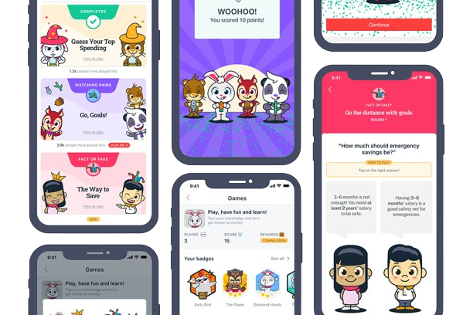
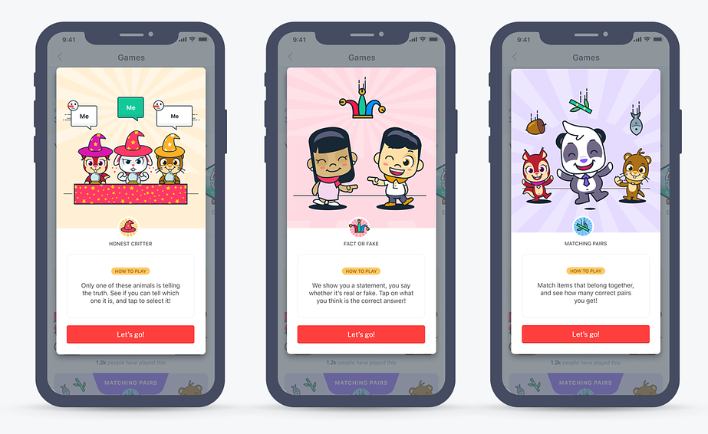
Design Assets / Inspiration
Basic Game Design
Multiple types/levels of Games
* Note : These are the inspiration for the final product ( Not the final product )

Slide 7
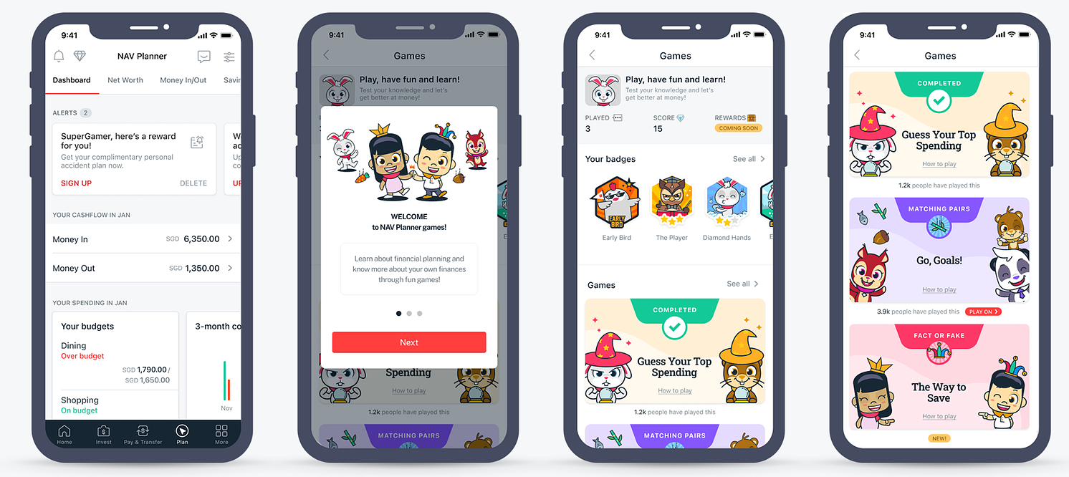
Design Assets / Inspiration
* Note : These are the inspiration for the final product ( Not the final product )

Slide 8
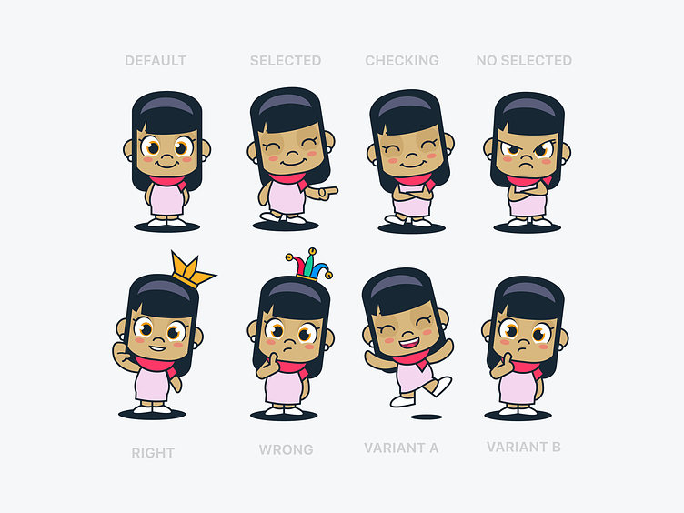
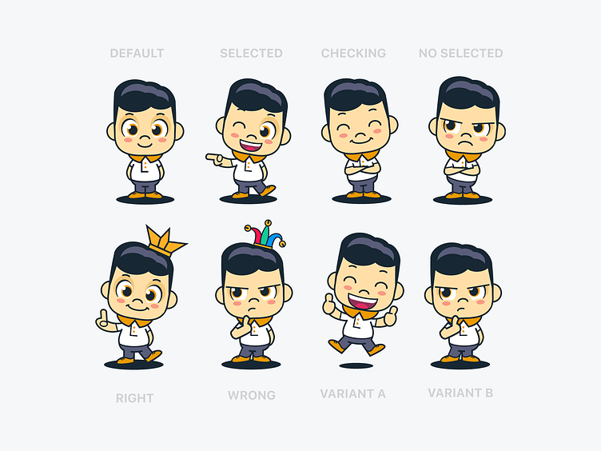
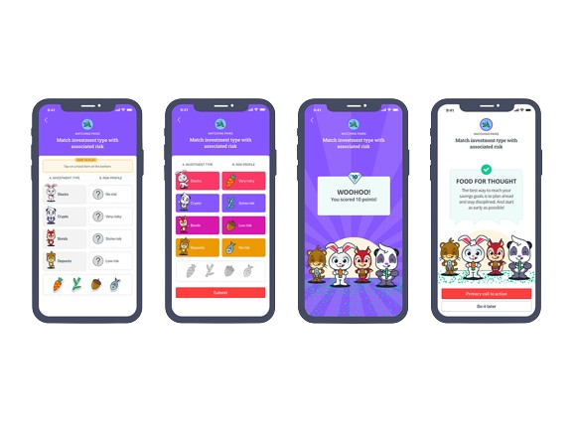
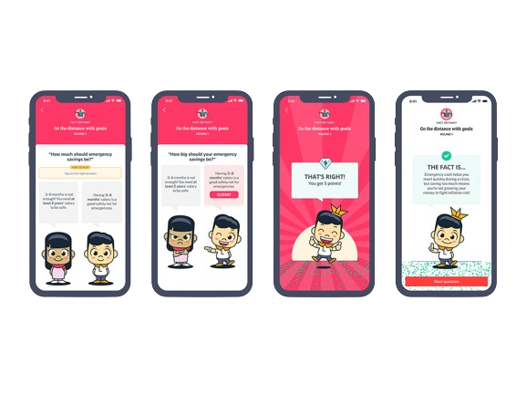
Character Assets and In game Design (Inspiration)
* Note : These are the inspiration for the final product ( Not the final product )

Slide 9
Workings of the Game
Game Features
Budgeting Challenges: Players face real-life scenarios where they must manage their finances wisely, allocating limited funds to essentials like rent, groceries, and entertainment.
Saving Quests: Users embark on exciting journeys to achieve specific financial goals such as saving for a dream vacation, building an emergency fund, or making a major purchase.
Investment Adventures: Players explore the thrilling world of investments, learning about stocks, bonds, real estate, and other options while balancing risk and reward.
Debt Management Missions: Players tackle debt head-on, learning effective strategies to prioritize and pay off debts efficiently, empowering them to achieve financial freedom.
Retirement Planning Expeditions: Users chart their course towards retirement, setting savings targets, exploring retirement account options, and making informed decisions for a secure financial future.
Gameplay Mechanics
A captivating level-based progression system challenges players with increasingly complex scenarios, fostering skill development and strategic thinking.
Interactive tutorials and guides accompany each financial topic, ensuring that players grasp concepts effectively and can apply them confidently.
Quizzes, puzzles, and mini-games provide an entertaining way to reinforce learning and test understanding, making the journey towards financial literacy both fun and educational.
Leaderboards and achievements inspire and motivate players to excel, rewarding progress and encouraging healthy competition among peers.
Social features such as multiplayer challenges, forums, and chat foster a sense of community, encouraging collaboration and mutual support among players.
User Experience
An intuitive and visually stunning user interface immerses players in the game world, with vibrant visuals and animations bringing financial concepts to life.
Personalized recommendations and feedback tailored to each player's performance and preferences guide their journey, ensuring a personalized and rewarding experience.
Accessibility features are incorporated to cater to users of all ages and abilities, ensuring inclusivity and equal access to financial education.
Regular updates with fresh content, challenges, and features keep the game engaging and dynamic, ensuring that players are continuously motivated and excited to learn and grow.

Slide 10
Simple Architecture
Client Application:
This is the front-end interface that users interact with. It could be a web application or a mobile app.
It communicates with the backend server to fetch data, send user inputs, and receive game updates.
Built using HTML, CSS, and JavaScript (React.js for web or React Native for mobile).
Backend Server:
Handles the game logic, user authentication, data storage, and communication with external services.
Implemented using Node.js to utilize non-blocking, event-driven architecture, suitable for real-time applications.
Hosted on Amazon EC2 for scalability and reliability.
Utilizes MongoDB as the database to store user data, game progress, and statistics.
File Storage:
Stores game assets such as images, videos, and sound files.
Amazon S3 is used for its scalability, reliability, and cost-effectiveness.
Real-time Database:
Firebase Realtime Database or Firestore is used for real-time data synchronization between clients and server.
Handles user interactions, progress updates, and game events in real-time.
Analytics & Monitoring:
Google Analytics and Mixpanel track user interactions, progress, and engagement metrics within the game.
New Relic monitors server performance, health, and user experience in real-time.
Authentication & Authorization:
Utilizes Firebase Authentication for user authentication and authorization.
Integrates with external authentication providers like Google, Facebook, or email/password authentication.
External Services:
Integrates with external services such as Algolia for search functionality, Amazon SNS for notifications, and sendwithus for email communication.
These services enhance the user experience and provide additional features like search, notifications, and personalized emails.
Development & Deployment Tools:
GitHub for version control and collaboration.
Travis CI for continuous integration and automated testing.
Papertrail for log management and error tracking.
Errorception for tracking and reporting JavaScript errors.
Brunch for compiling and optimizing game assets.
PagerDuty for alerting and incident response.

Slide 11
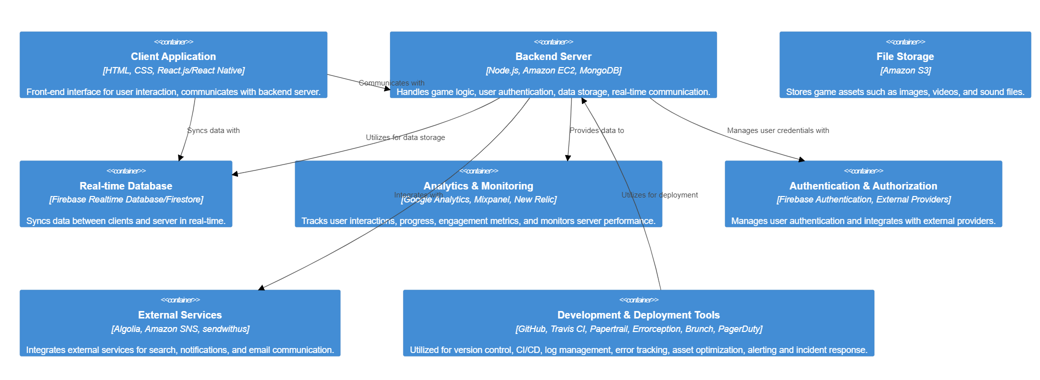
Methodology Appendix - Low Level Diagram of the solution

Slide 12
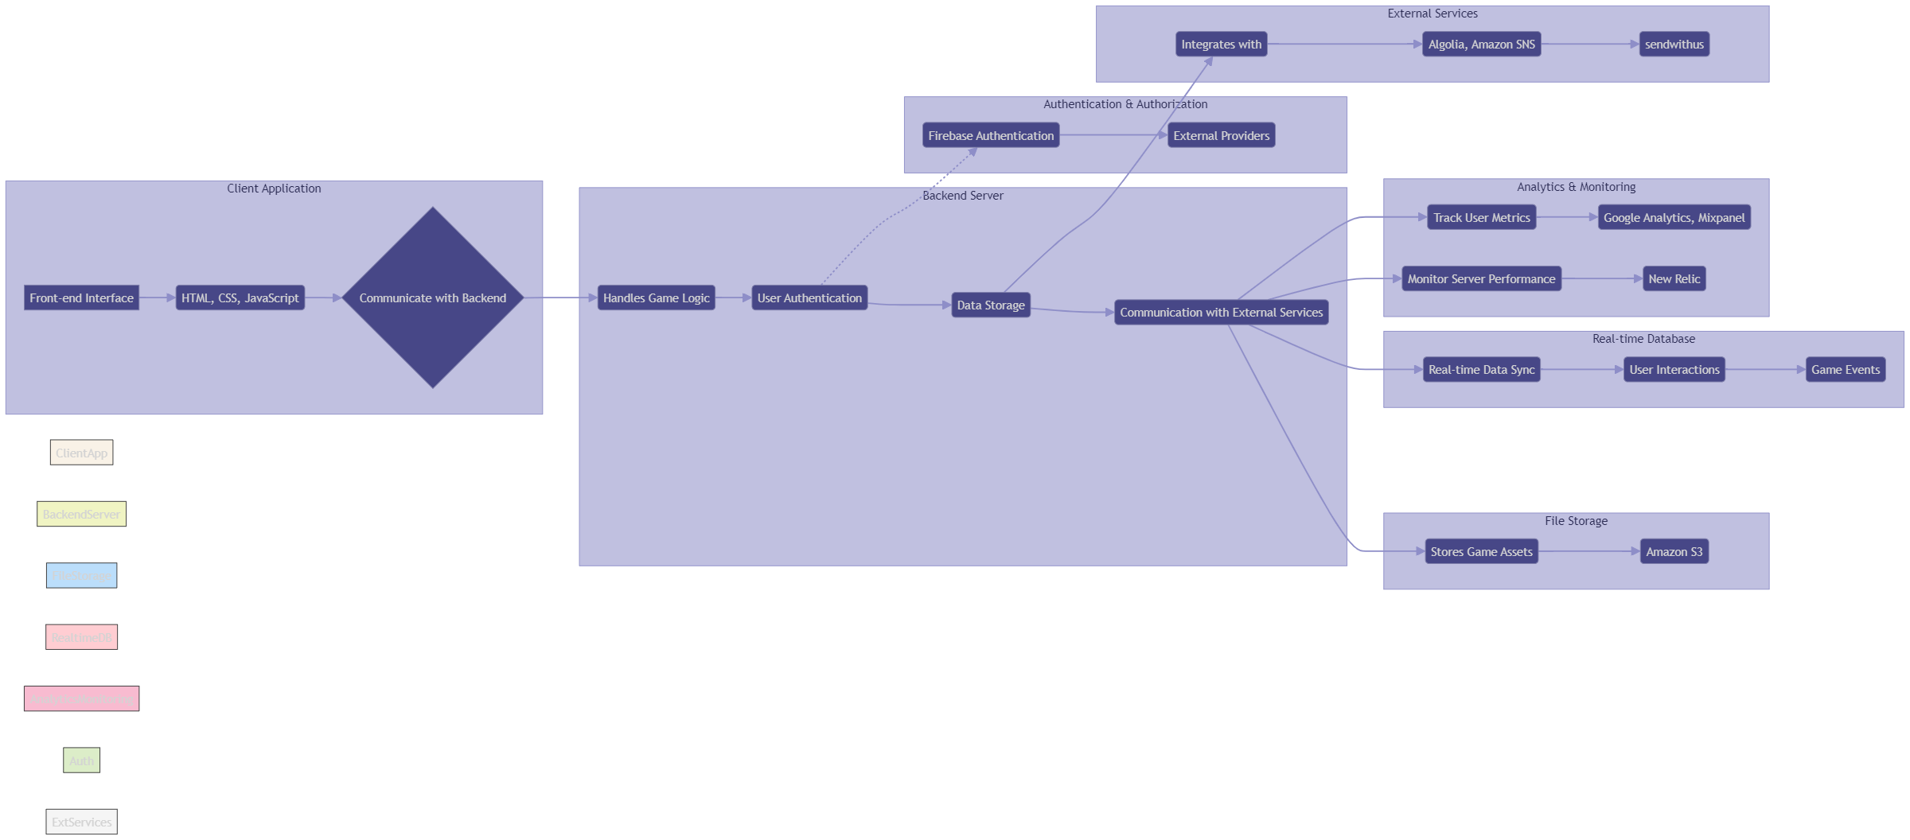
Methodology Appendix - Flowchart of the solution

Slide 13
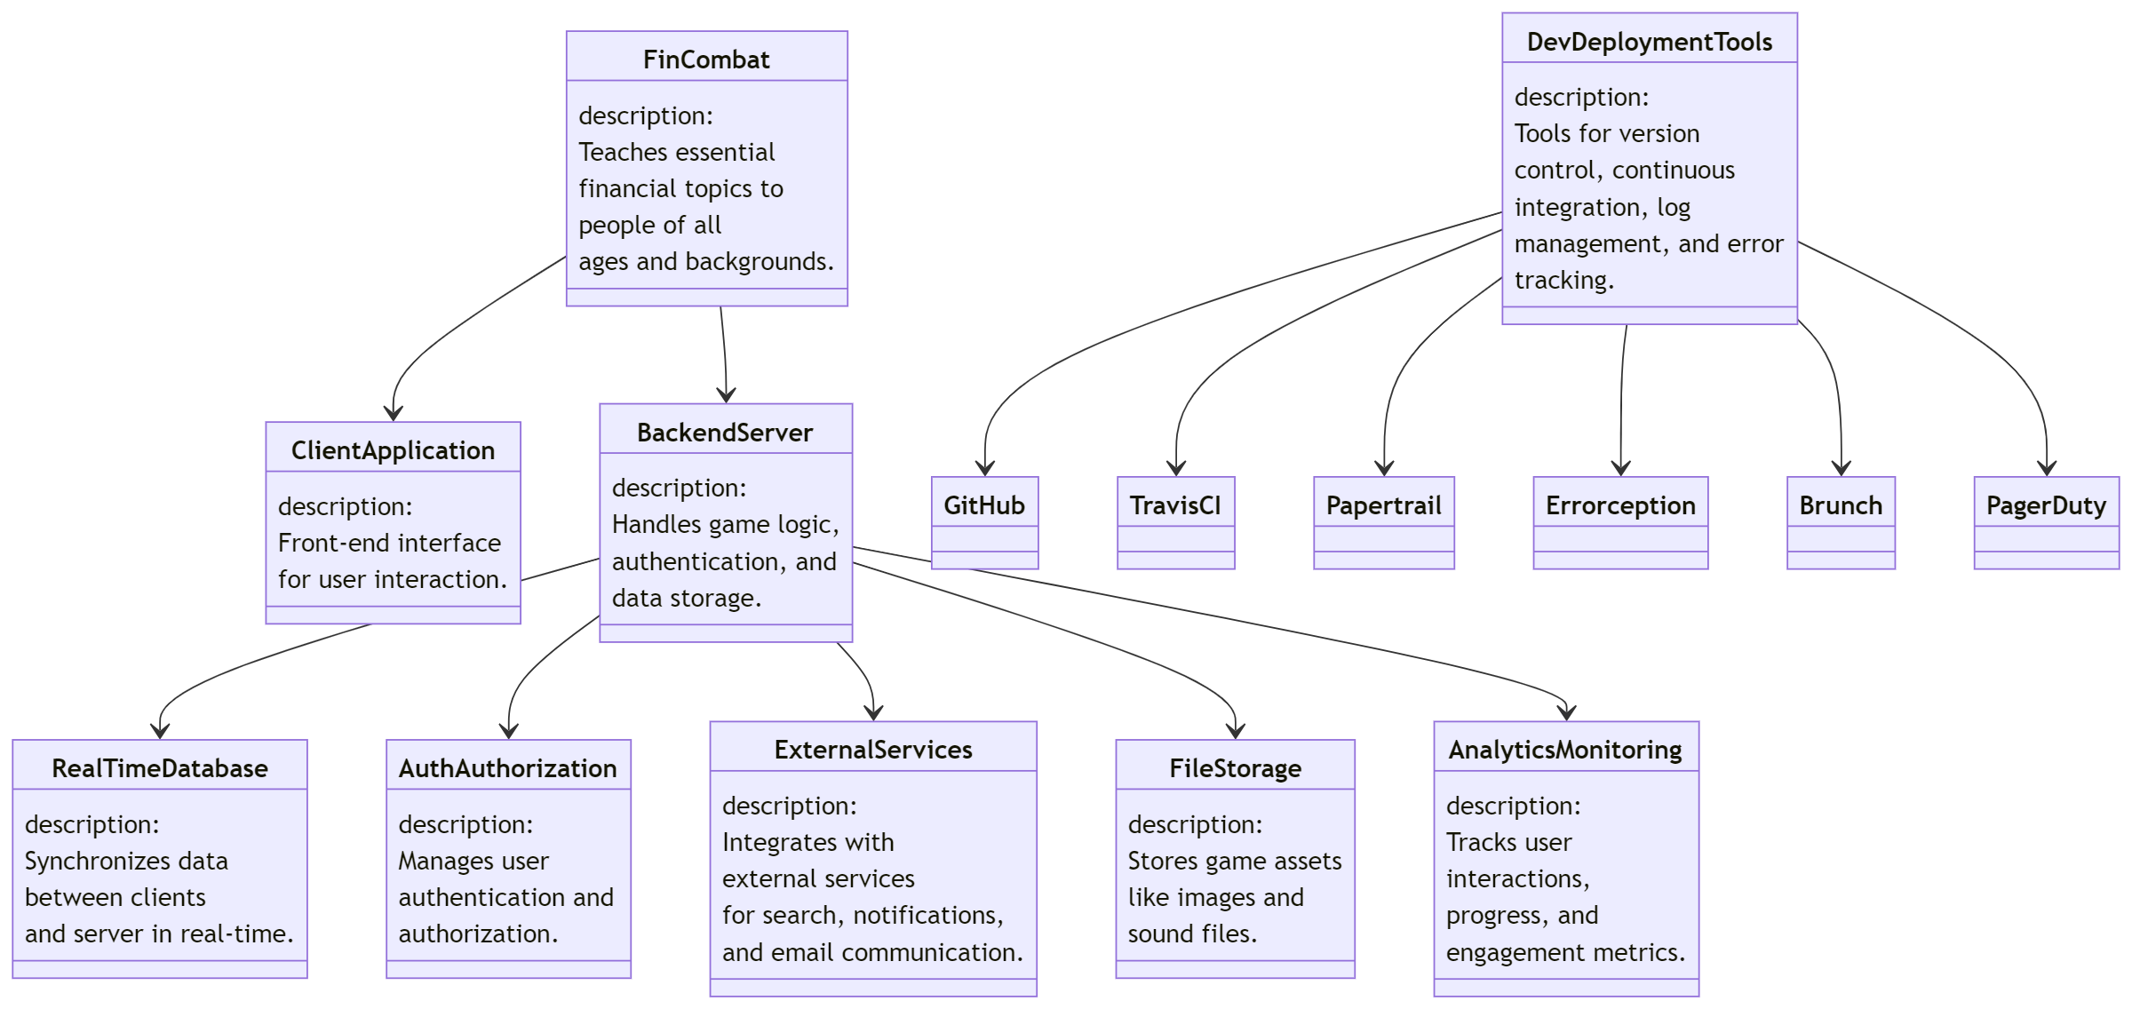
Methodology Appendix - Class Diagram of the solution

Slide 14
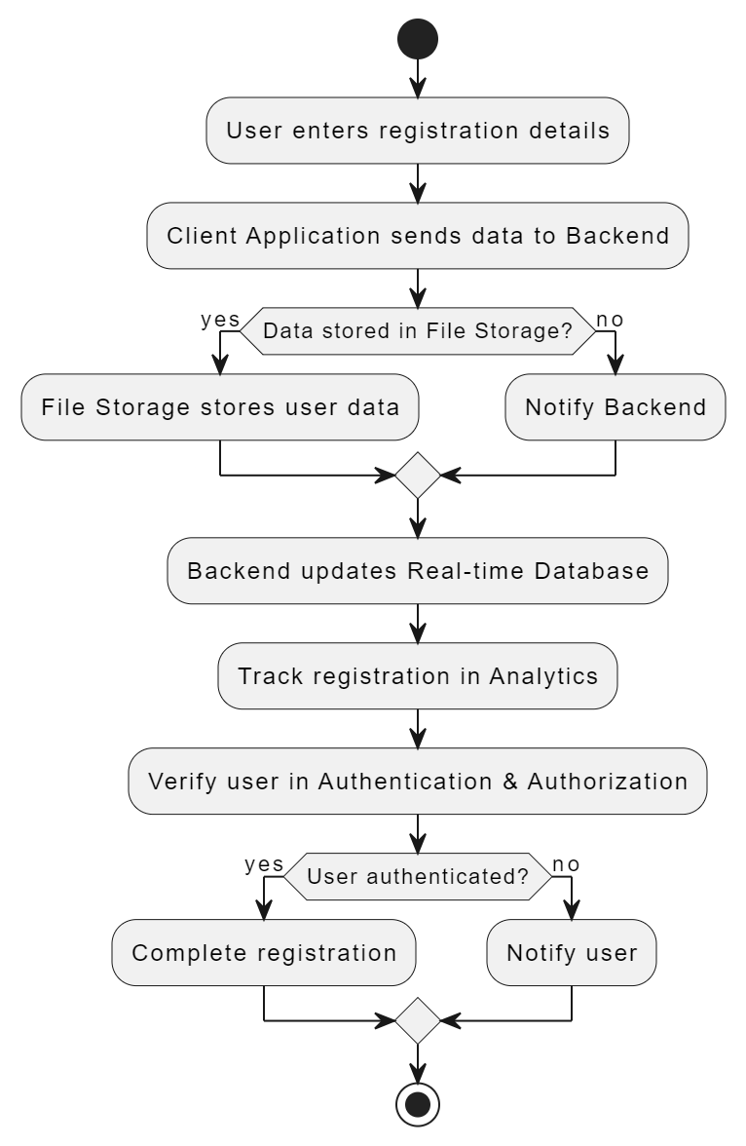
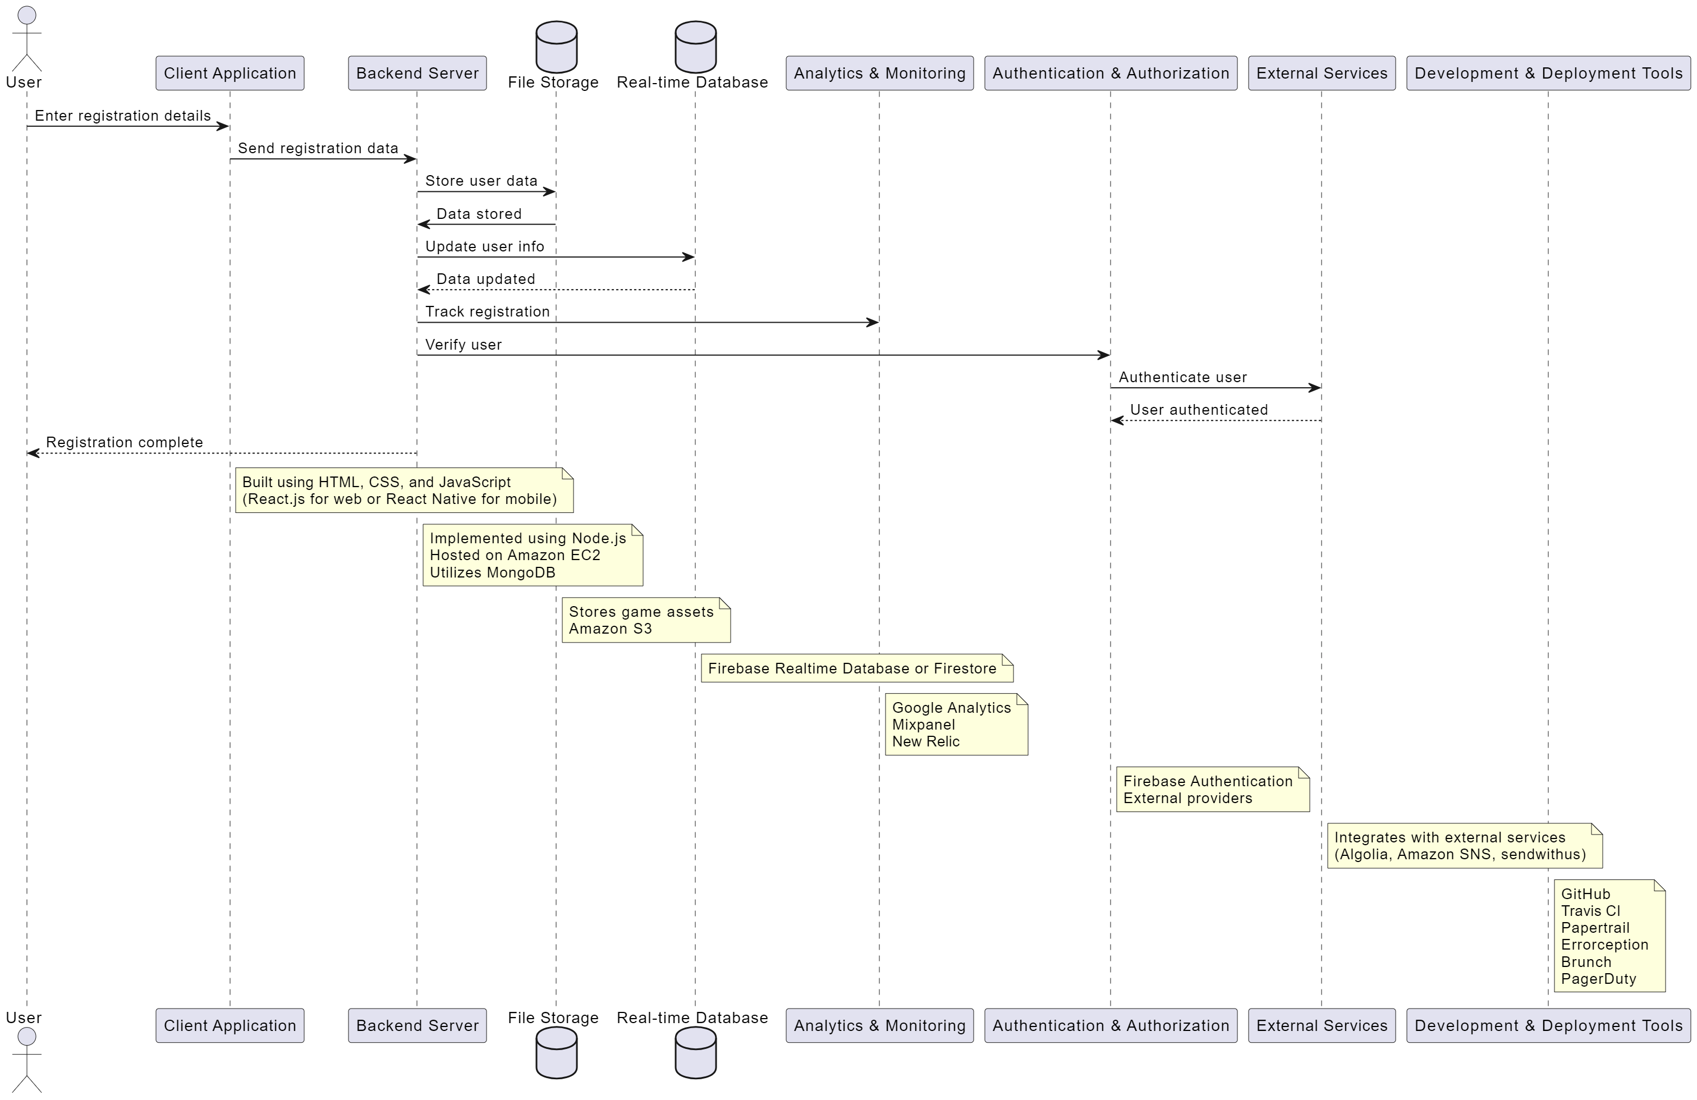
Data Flow Diagram & Unified Modeling Language Diagram

Slide 15
Societal Impact
Once adopted, FinCombat is poised to make a profound societal impact by significantly increasing financial literacy levels across diverse demographics. With only 27% of India's adult population currently financially literate, the need for accessible and engaging financial education is critical. FinCombat addresses this gap by offering an interactive platform where users of all ages and backgrounds can learn essential financial skills through gamified challenges and real-time feedback.
By empowering individuals with the knowledge and skills to make informed financial decisions, FinCombat has the potential to uplift communities and improve overall financial well-being. For example, studies have shown that every 1% increase in financial literacy can lead to a 0.1% increase in GDP growth. Moreover, closing the gender gap in financial literacy, where only 20% of women in India are financially literate compared to 27% of men, can contribute to greater gender equality and economic empowerment.
Furthermore, as users apply their newfound financial knowledge to manage their money effectively, they can break the cycle of poverty and build a more secure future for themselves and their families. By fostering a financially literate population, FinCombat lays the foundation for inclusive economic growth, reducing inequality and promoting long-term prosperity for society as a whole.

Slide 16
Future Scope
Business Relevance:
FinCombat holds significant business relevance as it addresses a pressing societal need for financial literacy while offering opportunities for monetization. With the global financial literacy rate at just 33%, the demand for effective financial education solutions is high. By providing an engaging and interactive platform, FinCombat attracts a wide user base, including individuals, educational institutions, and financial organizations. This broad market potential opens avenues for revenue generation through subscription models, in-app purchases, and partnerships with financial institutions seeking to promote financial literacy.
Optimization:
To optimize FinCombat, continuous refinement of content and features is essential. This includes updating gameplay mechanics based on user feedback, improving data analytics to personalize user experiences, and enhancing platform performance for seamless interaction. Additionally, leveraging machine learning algorithms to provide more accurate recommendations and insights can further optimize the platform's effectiveness in fostering financial literacy.
Scope for Modification:
FinCombat offers ample scope for modification to cater to evolving user needs and technological advancements. This includes expanding content offerings to cover advanced financial topics, integrating new gamification elements(like themes) to enhance engagement, and adapting the platform for emerging technologies like virtual reality or augmented reality. Moreover, flexibility in backend architecture allows for easy integration of additional services or third-party APIs to enrich the user experience and stay competitive in the market

Slide 17
Thank You

